Slide 1
SIH 2019
I/O HACKERS

Slide 2
Problem Statement
Aggregation app to check & monitor the outbreak of any water-borne disease.
It should have capability to mark on app - the location of detected cases.
The data should be available on the cloud & the same can be used by various agencies to take corrective measures.

Slide 3
Inputs: Outputs:
Who provides?
RELIABLE: Labs Hospitals(doctor) HMIS Data
UNRELIABLE: Normal Users Internet(FB, Twitter,news etc)
Reachability
INTERNET BASED Mobile Application Website
WITHOUT INTERNET Calling SMS

Slide 4
Progress Made
Hindi/English Calling + Tamil/Telugu/Punjabi/Kannada Support
Android UI - Backend Integration
Reporting from Android Application (AADHAR & Work Authorization upload)
Website UI - Backend Integration
Dynamic Addition of Hospitals/Dispensaries
Prediction for many more diseases and corresponding plots on Web Interface
Actual Data on Analysis Plots
Hospital CSV Upload Example
Notifications

Slide 5
Android Application
Heatmap
Predict map
Labs/Dispensaries
Live News updation
Geo-fencing
Reports for analysis
Predict disease via symptoms

Slide 6
Website
All android features
Weather data analysis
Various analytics via graphs and pie-charts
User can mark on the map about outburst of a disease
Add and locate nearby test labs and dispensaries

Slide 7
Calling & SMS
Prediction via Symptoms on call
Report on disease
Nagar nigam call
Replace Internet API call (Tollfree number)
Multi-language available (including english and hindi)

Slide 8
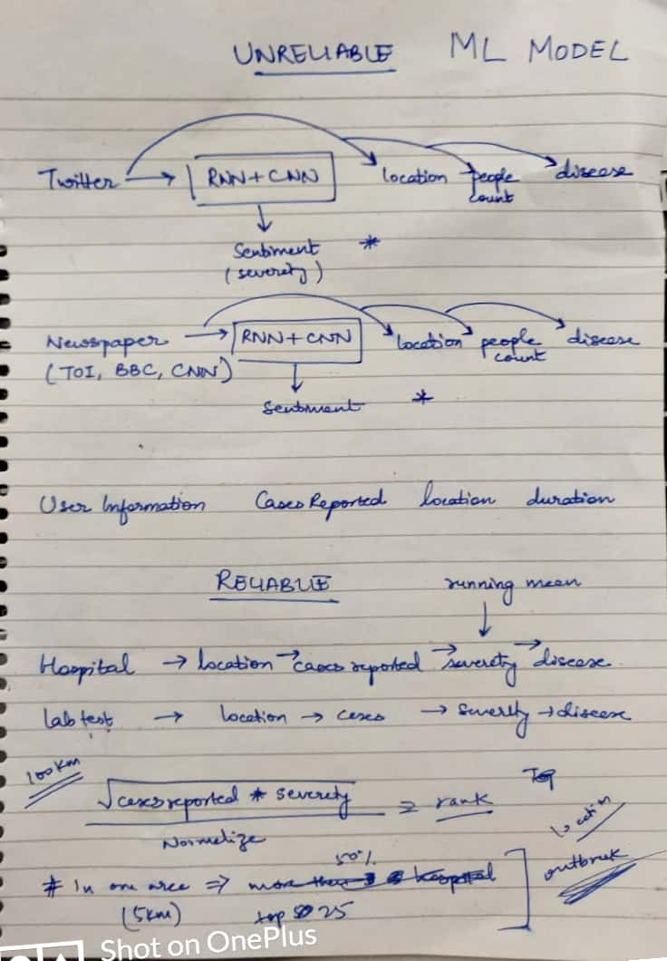
ML Model

Slide 9
Why Us?
EASY TO USE
DISEASE PREDICTION
SELF SUSTENANCE MONETIZATION MODEL
DIGITAL TRACKING OF PAST REPORTS
INTELLIGENT NEARBY LOCATION TRACKING
HIGH REACHABILITY EVEN TO DISCONNECTED* USERS

